Slide 1
Myntra App Analysis
Guide By : Vanisha Nagesh Mam
Presented by: Shruti Jain & Muskan Yadav

Slide 2
Problem Statement
Analyze Myntra app data to identify top brands, review and rating trends, individual clothing and gender-based category preferences, pricing strategies, and customer satisfaction.

Slide 3
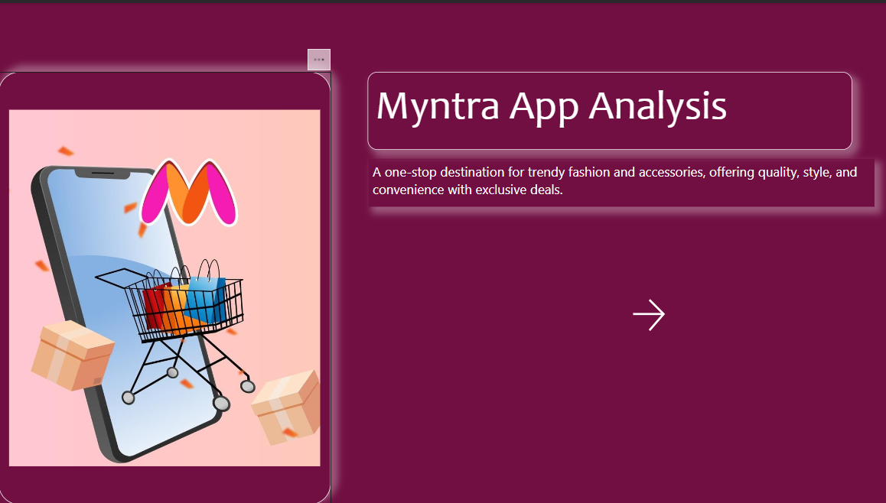

Slide 4
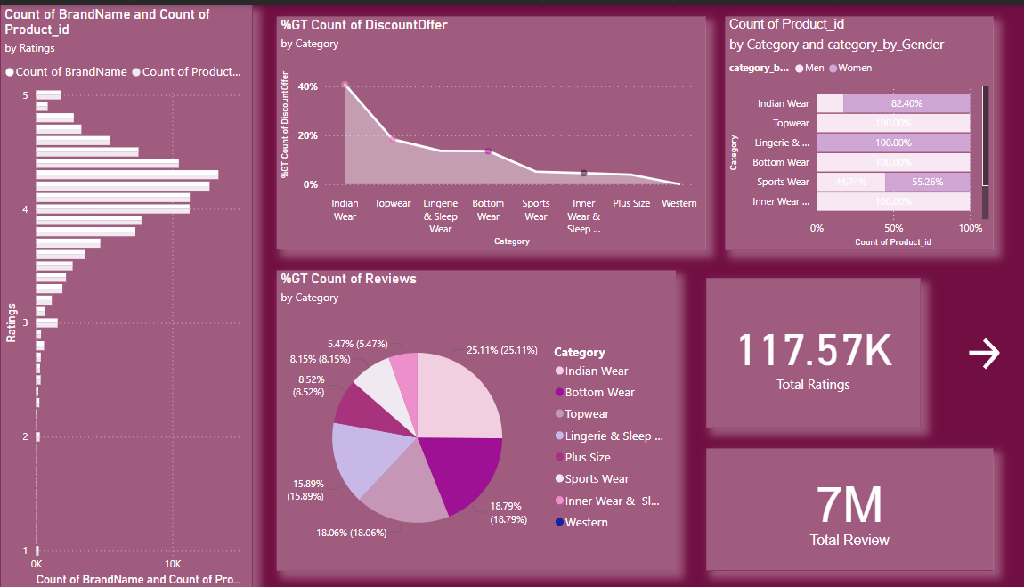

Slide 5
Myntra App Analysis:
Clustered Bar Chart :Count of Brand Name & Product by Ratings
High Ratings: Majority of products have 4-5 star ratings. Focus on promoting top-rated items.
Area Chart : %GT Count of Discount Offer by Category
Discount Offers: Highest in Indian Wear, lowest in Western Wear.
Action: Increase discounts in lower-offer categories to drive sales.
Pie Chart: %GT Count of Reviews by Category
Customer Reviews: Highest in Indian Wear (25.1%), Topwear (18.8%), Bottom Wear (18.1%).
Action: Encourage reviews in underrepresented categories.
Stacked Bar Chart: Count of Product by Category & Gender
Gender Based Preferences: Indian Wear is highly preferred by women (82.4%), Sports Wear has balanced interest (44.7% men, 55.3% women).
Action: Adjust product mix to align with gender preferences.
Product Ratings & Reviews Insights
Total Ratings: 117.57K | Total Reviews: 7M

Slide 6
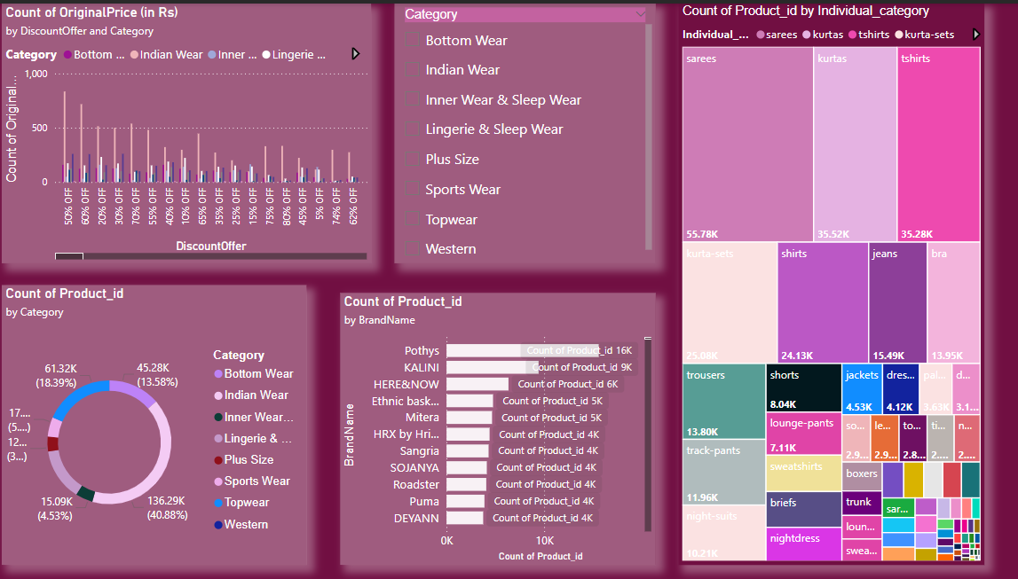

Slide 7
Product Analysis
Clustered Column Chart: Count of Original Price (in Rs) by Discount Offer and Category
High discounts (50-60%) are frequent, especially in Indian Wear and Lingerie & Sleep Wear.
Action: Maintain discount strategies for popular categories to encourage purchases.
Tree Map : Count of Product ID by Individual Category
Top Categories: Sarees (55.78K), Kurtas (35.52K), and T-shirts (35.28K) have the highest product counts.
Action: Focus marketing on these high-stock categories to maximize visibility and sales.
Donut Chart: Count of Product ID by Category
Topwear leads (136.29K), followed by Bottom Wear (61.32K).
Action: Optimize inventory in top categories to match demand and reduce excess stock.
Stacked Bar Chart : Count of Product ID by Brand Name
Top Brands: Pothys (16K), KALINI (9K), and HERE&NOW (6K) have the highest product counts.
Action: Collaborate with top brands for promotions to leverage their product volume.

Slide 8
Product Ratings & Analysis Summary
Overall Engagement:
Total Ratings: 117.57K | Total Reviews: 7M
Majority of products are highly rated (4-5 stars), indicating strong customer satisfaction.
Discount Insights:
Highest Discounts: Found in Indian Wear and Lingerie & Sleep Wear (50-60% off).
Action: Maintain high discounts in popular categories; consider increasing offers in Western Wear.
Top Categories by Product Count:
Sarees (55.78K), Kurtas (35.52K), and T-shirts (35.28K) lead individual product categories.
Topwear dominates overall category count (136.29K), followed by Bottom Wear (61.32K).
Action: Focus marketing on high-stock categories to maximize sales potential.
Top Brands by Product Count:
Pothys (16K), KALINI (9K), and HERE&NOW (6K) are leading brands.
Action: Collaborate with top brands for targeted promotions and improved visibility.
Gender Preferences:
Indian Wear is highly favored by women (82.4%); Sports Wear is balanced (44.7% men, 55.3% women).
Action: Adjust product offerings to align with gender trends in key categories.

